Slide 1
Sender Implementation
Patient Details:
public partial class PatientDetails : Form
{
public PatientDetails()
{
InitializeComponent();
}
BAL.BalProcess ObjBal = new BAL.BalProcess();
BO.PatientRegister PR = new BO.PatientRegister();
public string patient_id;
private void linkLabel1_LinkClicked(object sender,
LinkLabelLinkClickedEventArgs e)
{
Environment.Exit(0);

Slide 2
}
private void btn_submit_Click(object sender, EventArgs e)
{
bool result;
try
{
PR.Patient_ID = txt_patid.Text;
PR.Patient_Name = txt_name.Text;
PR.Age = txt_age.Text;
PR.Gender = txt_gender.Text;
PR.Blood_Group = txt_blood.Text;
PR.Disease = txt_disease.Text;
PR.Admit_Date = txt_admitdate.Text;
PR.Contect_No = txt_contactno.Text;
result = new BAL.BalProcess().BalPatientDetails(PR);
if (result)
{

Slide 3
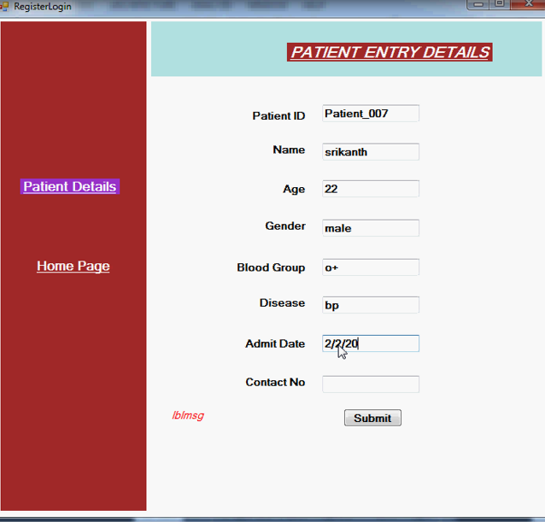

Slide 4
Admin:
public partial class Admin : Form
{
public Admin()
{
InitializeComponent();
}
private void linkLabel1_LinkClicked(object sender, LinkLabelLinkClickedEventArgs e)
{
Environment.Exit(0);
}
private void btn_login_Click(object sender, EventArgs e)
{
try
{

Slide 5
if (txt_name.Text == "Admin" && txt_passwd.Text == "Admin")
{
MessageBox.Show("Login Succefully..");
this.Hide();
ReserveRoom RR = new ReserveRoom();
RR.Show();
}
else
{
MessageBox.Show("Invalid username and password");
}
}
catch(Exception ex)
{
MessageBox.Show(ex.Message);
}

Slide 6
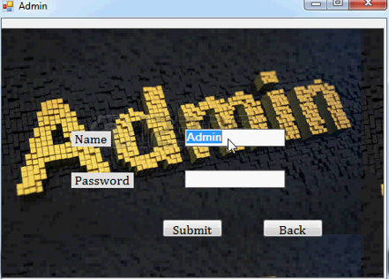

Slide 7
Doctor Login:
public partial class DoctorsLogin : Form
{
public DoctorsLogin()
{
InitializeComponent();
}
BO.DoctorRegister DR = new BO.DoctorRegister();
BAL.BalProcess ObjBal = new BAL.BalProcess();
private void DoctorsProfile_Load(object sender, EventArgs e)
{
}
private void llbl_login_LinkClicked(object sender, LinkLabelLinkClickedEventArgs e)
{

Slide 8
this.Hide();
DoctorRegister DR = new DoctorRegister();
DR.Show();
}
public static string passvalue = "";
private void btn_login_Click(object sender, EventArgs e)
{
bool result;
try
{
if (txt_name.Text != "" && txt_passwd.Text != "")
{
DR.Doctor_Name = txt_name.Text;
DR.Password = txt_passwd.Text;
result = ObjBal.BalDoctorLogin(DR);
if (result)
{

Slide 9
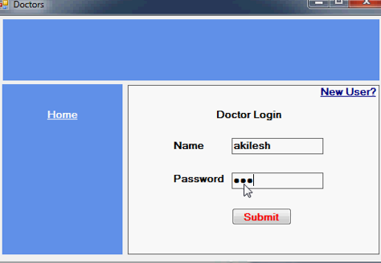

Slide 10
Doctor Registration:
public partial class DoctorRegister : Form
{
public DoctorRegister()
{
InitializeComponent();
}
BO.DoctorRegister DR = new BO.DoctorRegister();
BAL.BalProcess ObjBal = new BAL.BalProcess();
private void DoctorLogin_Load(object sender, EventArgs e)
{
}
this.Hide();
HomePage HP = new HomePage();
HP.Show();
{

Slide 11
this.Hide();
DoctorsLogin DL = new DoctorsLogin();
DL.Show();
}
private void llbl_back_LinkClicked(object sender, LinkLabelLinkClickedEventArgs e)
{
this.Close();
HomePage HP = new HomePage();
HP.Show();
}
private void btn_submit_Click_1(object sender, EventArgs e)
{
bool result;
try
{
if (txt_doctorname.Text != ""&&txt_password.Text!="" && txt_specalist.Text!=""&& txt_gender.Text!=""&& txt_emailid.Text!=""&&txt_contactno.Text!=""&&txt_country.Text!=""&&txt_appoimentdate.Text!="")
{

Slide 12
